Slide 1
Introduction to Negotiation
EIT Digital Master School @Eötvös Lorand University
Business Development Lab
Inspired by “Negotiation Analysis: An Introduction” by Michael A. Wheeler
Harvard Business School Background Note 801-156, August 2000. (Revised December 2014.)

Slide 2
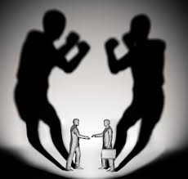
Negotiation
Give and take process between two or more parties (each with its own aims, needs, and viewpoints) seeking to reach an agreement to settle a matter of mutual concern.
*http://www.businessdictionary.com/definition/negotiation.html

Slide 3
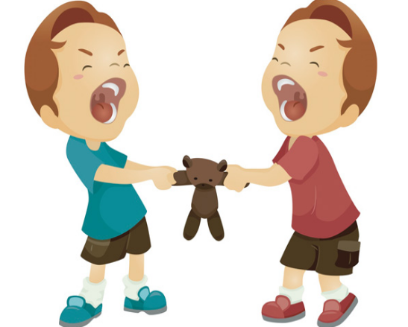
How to Negotiate?
People often ask the wrong questions when they prepare for negotiation.
Effective negotiation requires a coherent framework linking means and ends.

Slide 4
7 questions to answer before
Negotiation involves analysis of a different set of issues :
1.BATNAs: What to do if no agreement is reached?
2.Parties: Who are the real parties in the negotiation?
3.Interests: What are their fundamental needs and priorities?
4.Value: How can value be created and who gets it?
5.Barriers: What obstacles might prevent agreement?
6.Power: How can the parties influence negotiation?
7.Ethics: What is the right thing to do?

Slide 5
1- BATNAs
Negotiation is a consensual process.
Agreement happens when the parties believe the deal is better than walking away from the bargaining table.
Best Alternative To a Negotiated Agreement: what one will do if an agreement is not reached.
* Fisher, Ury, and Patton, Getting to Yes, 2d. ed. (New York: Penguin, 1991).
Agree
Walk Away

Slide 6

1- BATNAs
Your BATNA is your preferred course of action. It is not your bottom line.
Identify your best alternative and put a value on it: this is your “walkaway”.
Walkaways should consider all of your various interests—tangible and not.
Care about $$$ but also: ease of consummating the deal, time pressure, relationships, risk tolerance

Slide 7
1- BATNAs
A rigid bottom line (hard dollars-and-cents hurdle) can be dangerous:
self- fulfilling prophecy
blind you to creative solutions.
Look for favorable terms: (ex. For the cable case) financing package at a generous interest rate

Slide 8
1- BATNAs Assessment
Most people are not very good at evaluating BATNAs (over-optimism).
Assessing them involves:
Science: specifying the plausible alternative agreements and rating. Tools of decision analysis and micro-economics.
*Hammond, Kenney, and Raiffa, Smart Choices
Art: imagining creative alternatives and weighing their relative value.

Slide 9

1- BATNAs
Consider the perceived BATNAs of both parties.
Excellent BATNA: ex. negotiating with a prospective employer after already getting an offer from another.
Terrible BATNA: ex. get a hotel room on a busy holiday weekend, with your kids sick and your car broken.

Slide 10
1- BATNAs – UC*
Frank Park is the sole owner of a cable television decided to sell his business.
Gulf Cable, a regional company, has already offered him $10,000,000 in cash,
C-Com, the national telecommunications giant seems interested
What is the owner's BATNA with C-Com?
Naive answer: accept the $10,000,000 offer from Gulf Cable (doesn’t consider strength of the cable industry )
Seeking out other potential bidders
Or responding to Gulf Cable with a counter-offer (say, $11,500,000).
Accept a lower figure from C- Com. For example, if he would get some shares in the acquiring company as part of the deal.
*Harvard Business School Background Note 801-156, August 2000. (Revised December 2014.)

Slide 11
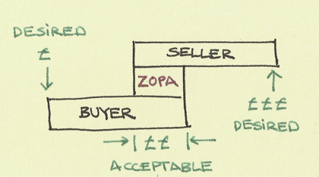






1- BATNAs – UC*
Assume that parties only want cash:
Park is prepared to accept ($10,000,000 from Gulf Cable) unless C-Com is willing to do better.
C-Com financial analysis justifies paying up to $13,000,000.
There would be a bargaining range from $10,000,000 to $13,000,000.
*Harvard Business School Background Note 801-156, August 2000. (Revised December 2014.)

Slide 12
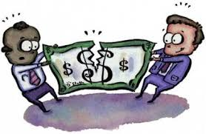
1- BATNAs : ZOPA
A bargaining range = Zone Of Possible Agreement
Any price between those two figures
There is no "correct" figure or equilibrium.
The parties do generate gain anyway.
Zero-sum situation: any +$ for the seller = -$ for the buyer.
A single-issue negotiations (such as those over price) are often called distributive.

Slide 13
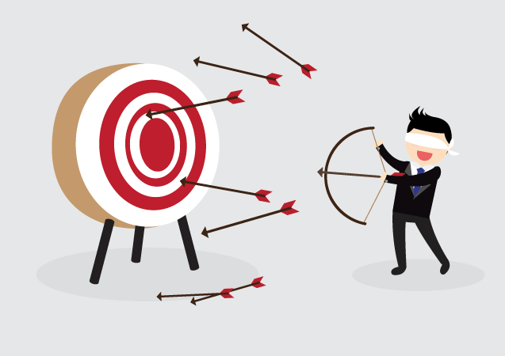
1- BATNAs and ZOPA in practice
it is hard to have an accurate picture
circumstances change during the bargaining process
these assessments must be regularly updated

Slide 14

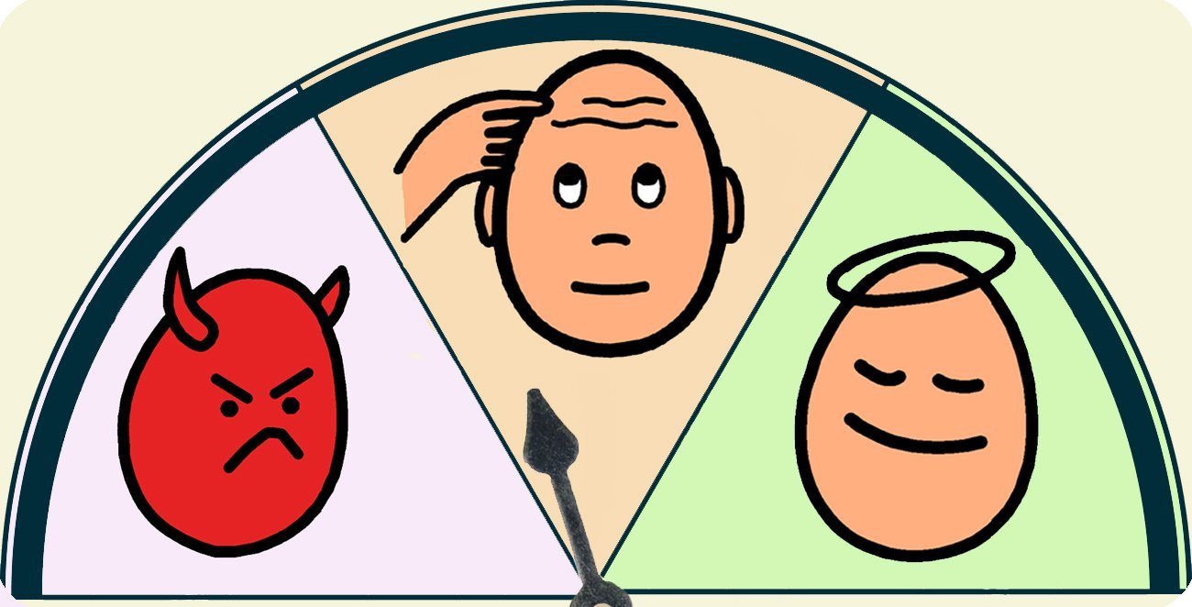
1- BATNAs: the other side's walkaway
May provide some clues:
General market conditions
The behavior (apparent interest in making a deal)
The pattern of offers and concessions

Slide 15
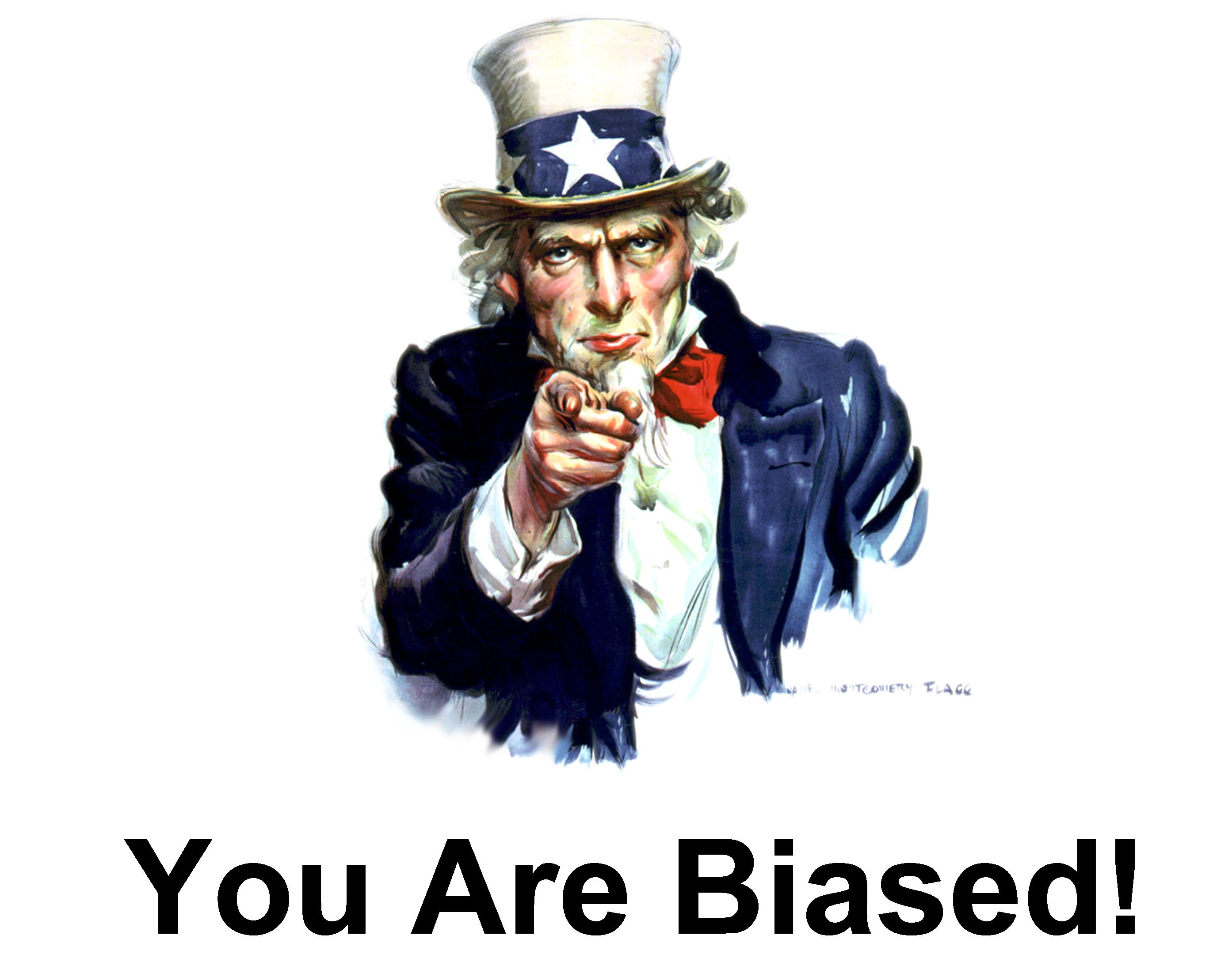
1- BATNAs: the other side's walkaway
Almost always incomplete and subject to interpretation.
Easy traps:
how they should see their BATNA, instead of how they really do.
self-serving biases: ex. threatening of a lawsuit believing others are scared of the costs of a trial.

Slide 16
1- BATNAs in short
One of the early tasks in negotiation is to understand:
our BATNAs,
how the other party views its alternatives
as well as how it perceives our own
This can be a time- consuming and frustrating process.
Playing with offers and counteroffers is a way to 2 and 3.
Risks: if the parties are too coy, they may fail to come to agreement and see that there is a ZOPA.

Slide 17
2- Parties
There may be influential players who are not immediately visible
Would getting the support of Party A increase or decrease the subsequent chances of getting Party B on board?
Are we talking to the right person?
Take, for example, the familiar case of buying a new car

Slide 18

2- Parties: ex.
The salesman
build a relationship with customer
get him psychologically committed to buy

Slide 19

2- Parties: ex.
The manager
distant and intimidating
squeeze the last dollars out of the bargain

Slide 20
2- Parties – UC*
What Frank Park did:
He pursued a parallel roll-up strategy in which he would acquire other small cable systems in his part of the state.
Putting a cluster of systems together would give him greater purchasing power.
This meant expanding his list of negotiating parties to include owners of other systems in his area.
*Harvard Business School Background Note 801-156, August 2000. (Revised December 2014.)

Slide 21
2- Parties in short
Identifying the current and potential parties may :
Raise other important questions, tough to answer
Expose to potential pitfalls and opportunities
This reveals ways to favorably change the game.
Instead of passively reacting you can shape the environment in order to increase the chance to satisfy your needs.

Slide 22
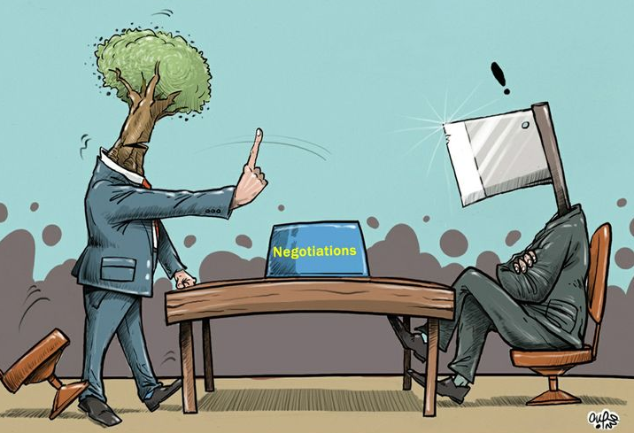
3- Interests
What are the interests and priorities of the key parties? many negotiators fail to ask, even of themselves.
Also are often too cautious about revealing our interests, fearful of being exploited, but if we exaggerate: little chance of maximizing the potential value deals.

Slide 23
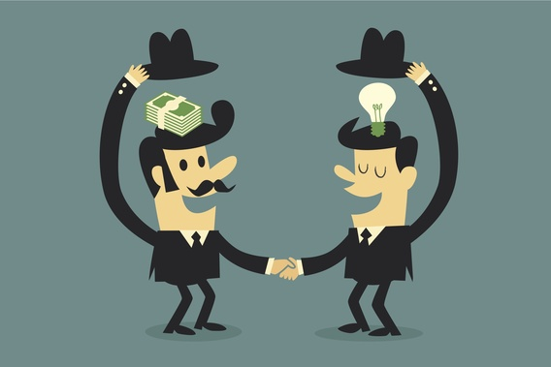
3- Interests
Some interests other than money:
Reduce tax obligations
Balance immediate needs for liquidity against long-term capital
Associated risks and in what form
Timing (ex. other acquisitions, delay an announcement. Or depending on other investment decisions)

Slide 24
3- Interests – UC*
Frank Park approached the head of Aurora Partners and had months of arduous bargaining:
Aurora thought they were worth $15,000,000 cash,
Their price was several million dollars above Frank limit (GAP)
Focus on interest, not positions: “how much would you be willing to pay for ours?"
After a bit of bargaining, they settled on the sale of Park's system at $14,500,000
Park temporarily forgot that purchasing the second system was simply a means toward the goal of maximizing economic value.
Meanwhile he discovered had other interests, as well: concerned about his loyal employees and local programming.
*Harvard Business School Background Note 801-156, August 2000. (Revised December 2014.)

Slide 25
3- Interests in short
Assessing interests is important before during and even at the end of negotiation:
Negotiation involves discovery
Without a refined sense of one's own objectives and trade-offs, it is hard to formulate a strategy or judge success.
Interests can evolve and strategy should adapt to changing goals and circumstances.

Slide 26
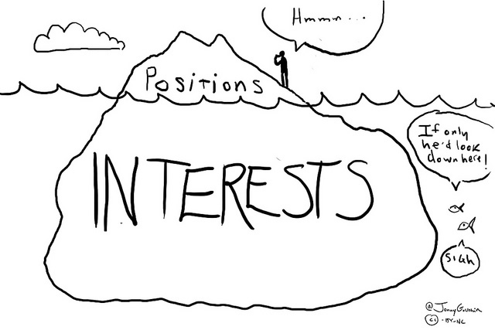
4- Value
How can value be created—and who will get it?
The potential for value- creation ultimately depends on how the other parties' interests compare with your own.
Rarely are the interests of other stakeholders entirely clear.

Slide 27
4- Value – UC*
Frank Park and Aurora:
Instead of a ZOPA there was a significant GAP
A difference in valuation foreclosed one particular deal but it opened the opportunity for another.
Differences are the core material for value creation in negotiation.
If these two parties completely agreed on the economic worth of their cable systems, they would have little incentive to buy or sell.
The parties essentially created $3.5 million of surplus value.
*Harvard Business School Background Note 801-156, August 2000. (Revised December 2014.)

Slide 28
4- Value – UC*
If they could gain $1,000,000 in tax savings, there is a value creation that can be represented in the two-dimensional ZOPA diagram:
A = the $14.500.000 cash deal.
B = the seller get all the tax savings
C = the buyer get all savings, pay only $13.500.000
BC = alternative deal structures
*Harvard Business School Background Note 801-156, August 2000. (Revised December 2014.)
seller's interests
B
15.5
14.5
A
C
13.5
buyer's interests

Slide 29
4- Value: key lessons
It is wrong to assume that negotiation has to be win-lose
It is possible to reach agreements that create gain for both parties
But it is wrong to see negotiation simply in win-win terms. Being too aggressive or too meek is not the answer.
The creation of mutual gains does not necessarily mean that they will be evenly divided.

Slide 30
4- Value: key lessons
Creating value usually requires revelation of information and brainstorming: be cautious about revealing desires and masking true interests.
Establish the right problem-solving atmosphere to maximizes benefit
At some point one party's well-being cannot be further improved without hurting the other's: aim to a "Pareto optimal“ solution

Slide 31
4- Value in short
Value in negotiation is generated by capitalizing on differences, not necessarily by finding common ground.
Differences may be in:
valuation,
expectations,
discount rates,
attitudes toward risk…
Unless they are creatively exploited, the parties will lose opportunities that could benefit them both.

Slide 32

5- Barriers
What obstacles might prevent agreement (or the maximization of value) and how can they be overcome?
Several formidable barriers may stand in the way
Identifying such obstacles—and the means for overcoming them—is a key for negotiation analysis

Slide 33

5- Barriers
Strategic behaviour
Parties hold out, hoping the other will increase his bid, so both lose a potentially good deal.
The same goes for value-creating opportunities.
Weigh the benefits and risks of specific bargaining tactics.
The risk is that your demand will exceed what the other party is willing to accept.

Slide 34
5- Barriers
Psychological or interpersonal
Lack trust or troubles in communicating
Harbour suspicions from earlier experiences or social stereotypes
Emotions can run high in negotiation
Issues of perceived power and status
You never completely control your own destiny. This can be unsettling.
You regard other parties as opponents, being defensive and even hostile.
For helpful advice on managing the negotiation process see:
Fisher, Ury, and Patton, Getting to Yes, 2d. ed. (New York: Penguin, 1991);
Ury, Getting Past No (New York: Bantam, 1991);
and Shell, Bargaining for Advantage: Negotiating Strategies for Reasonable People (New York: Viking, 1999).

Slide 35
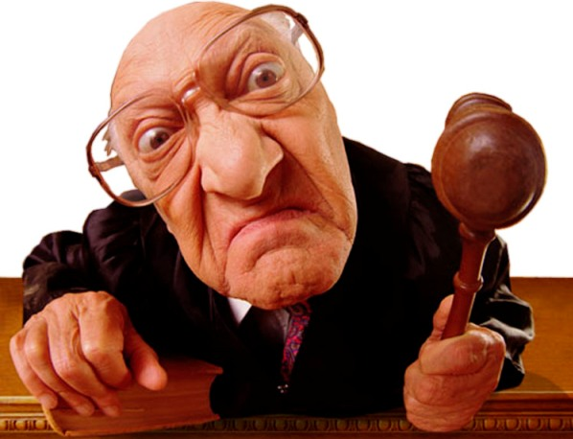
5- Barriers
Institutional
Legal constraints may inhibit value creation, as well.
Even if a deal were widely supported, the trade might be illegal.
Overcoming institutional barriers may require crafting new policies.

Slide 36
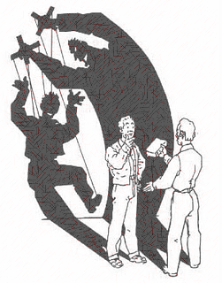
6- Power
How can the various parties influence the negotiation process and its outcomes?
Bargaining power: what it really means?
Sometimes assumed to be simply the strength or weakness of your BATNA but this is not enough.

Slide 37

6- Power: as BATNA
A good BATNA: simply insures you against having to accept too little.
Having a wonderful job already is great, but it won't make other companies pay you more than they believe you are worth.

Slide 38
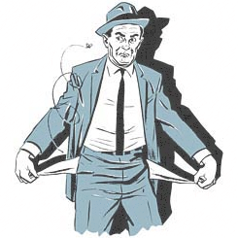
6- Power: as BATNA
A poor BATNA: the other side may not know or it may prize more what you have to offer.
"Owe the bank $10,000, and you've got a problem. Owe the bank $10,000,000, and they have a problem."
In that position you have little to loose, hence it can be hard to negotiate with you.

Slide 39
6- Power: how to use it
Think: Identify ways in which you can positively use it to change the negotiation.
Time: Setting deadlines can constructively force people to reach agreement.
Attack BATNA: try to worsen the consequences of refusing your offer. Dangerous approach that invite retaliation. Threatening degenerate into battles of principle and potential great costs.

Slide 40
6- Power in short
“A manifestation of complex situational factors”.
A matter of Perception: having a good BATNA will give you no advantage unless the other are convinced that you are prepared to walkaway.
Knowledge: ex. convincing the other parties that you will wait forever to get the terms that you want.
Skill: from strategic vision and creativity to persuasiveness and self- confidence.

Slide 41
7- Ethics
What is the right thing to do?
5 questions that negotiators should ask themselves if they are to act responsibly.
None of these are easy.
All the more reason for not improvising one's moral standards at the bargaining table.

Slide 42

7- Ethics Q1: Lying?
What the other party will do with disclosure (reciprocate honesty?)
Are there moral reasons to evade answering some question?
Ex. Professional salespeople can protect their own interests. What about some inexperienced neighbourhood teenager? You might want to honor a higher standard of disclosure.

Slide 43
7- Ethics Q2: being Fair?
Aa
Should you be concerned with the fairness of the agreement?
“The greatest good is achieved if everyone has an incentive to look after his or her own wellbeing”.
This ignores long-term reputational impacts.
“None of us should get rich at other people's expense, something is lost for us all if we simply regard each other as economic actors.”

Slide 44

7- Ethics Q3: use Force?
Physical pressure is wrong, what about economic one?
Ex. “If the demand grows you rise price”:
Tickets for tourist highly frequented routes.
Travel for great illness.
Helpful considerations:
the parties has plausible alternatives?
what responsibility he bears for putting himself in a position of need?

Slide 45

7- Ethics Q4: impact on Others?
What is the impact of negotiation on bystanders?
How your agreement will affect people who are not at the bargaining table?
The political process might grant some protection.
There are certainly other situations in which people have a stake but no voice.

Slide 46
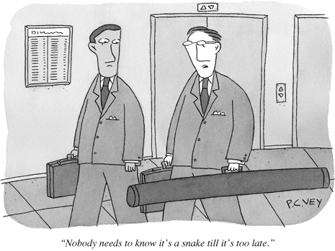
7- Ethics Q5: Moral on behalf of others?
Moral issues when one is negotiating on behalf of others.
Must individuals abandon their own personal values and standards when they accept jobs?
“Bargaining tactics that would be improper if we did them ourselves, cannot become permissible if they are done on behalf of our employer.”
*Applebaum, Ethics for Adversaries: The Morality of Roles in Public and Professional Life (Princeton: Princeton University Press, 1999).

Slide 47
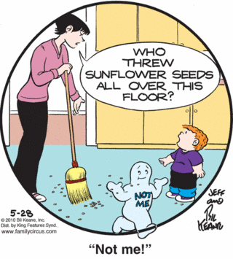
7- Ethics in short
Your words and deeds define your relationship with others.
Negotiation strategy must be based on carefully considered principles.
Do not act first then constructing a rationale to justify your behavior.
It can be dangerous for others and for yourself.

Slide 48
Negotiation – a recap
Through formal study and reflection on experience you can develop a negotiation strategy, rather than just improvising it.
The presented framework* requires:
Clear assessment of all the parties' BATNAs.
Identifying their fundamental interests as the source of potential value-creating trades.
Recognizing possible barriers to agreement.
All of these tasks require moral and ethical thinking as well.
*Harvard Business School Background Note 801-156, August 2000. (Revised December 2014.)

Slide 49
Negotiation – a recap
Rigorous negotiation analysis is necessary but not sufficient for success. You’ll need:
Skill and insight.
The ability to listen and persuade.
Patience (and sometimes even humour).
Negotiation is interactive, success is also contingent on your counterparts' attitudes.
Thus your own negotiation strategy should encourage constructive behaviour.

Slide 50
Thank you!
Brought to you by EIT Digital Master School @Eötvös Lorand University
Find me at: anna.reale@inf.elte.hu

